Slide 1
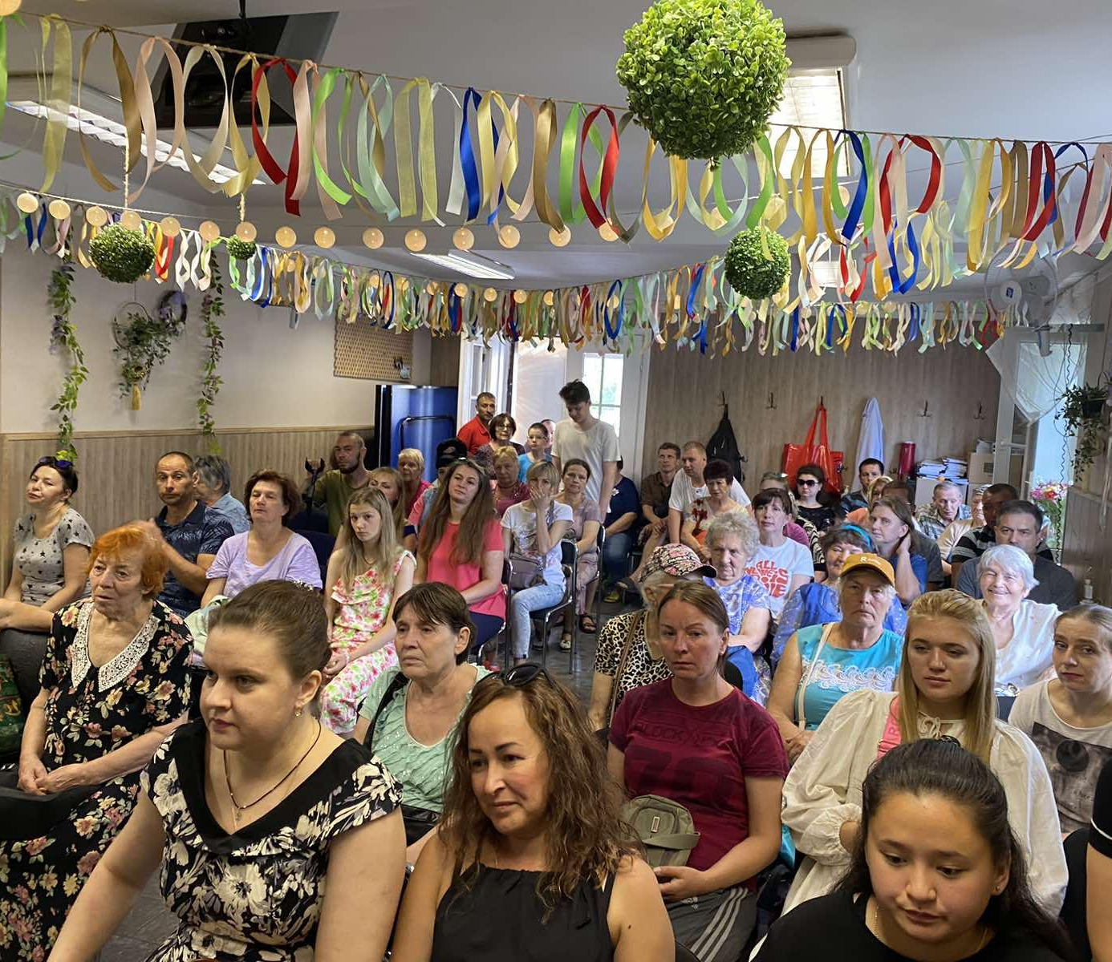
Church of Christ on Obolon
Kyiv, Ukraine
www.obolon-church.kiev.ua

Slide 2
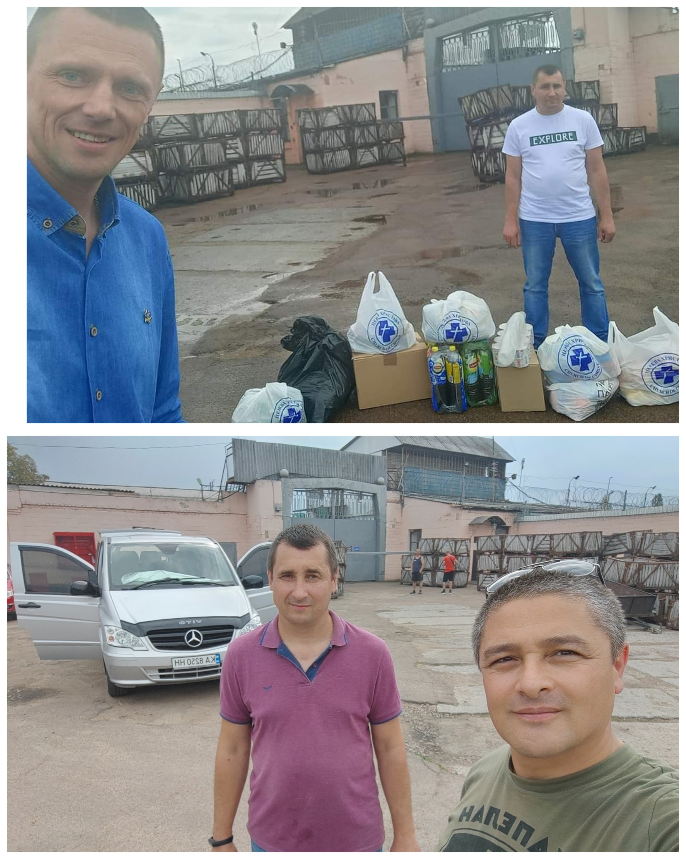
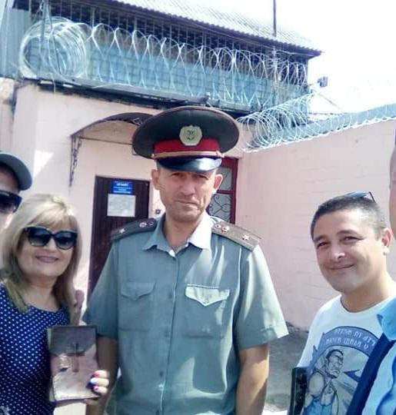
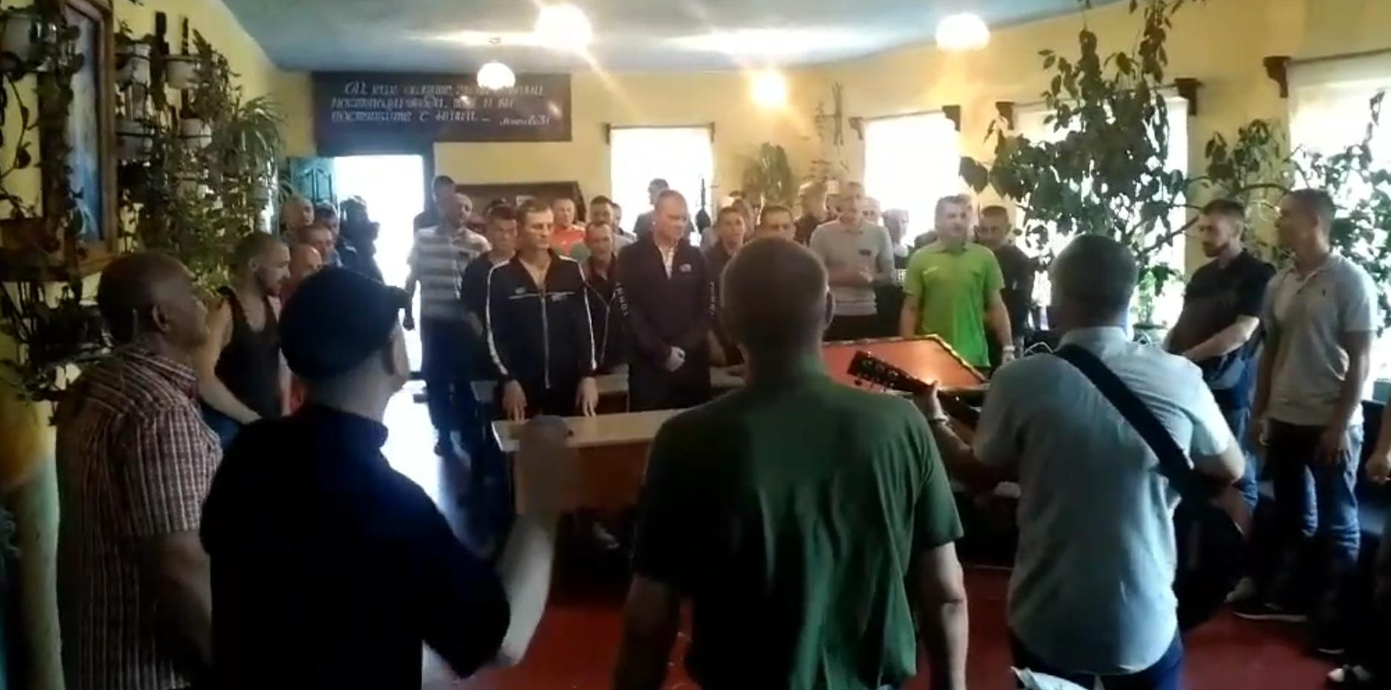
The main directions of service today:
1 - Work with prisoners, preaching, rehabilitation, adaptation.

Slide 3
The church has been engaged in prison ministry for many years. We regularly visit various colonies, preach and instruct prisoners so that they can become Christians. After release from prisons, work and adaptation to life is carried out with them. Many such Christians remain in the church and start families.

Slide 4
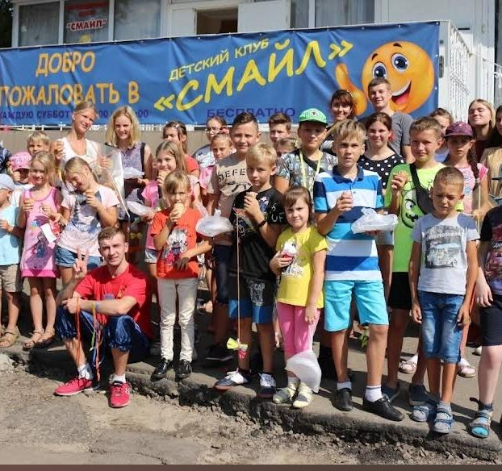
2 - The next permanent service is working with children.
Children of community members join the church service, as well as just children from the streets who were invited and now regularly attend the service

Slide 5
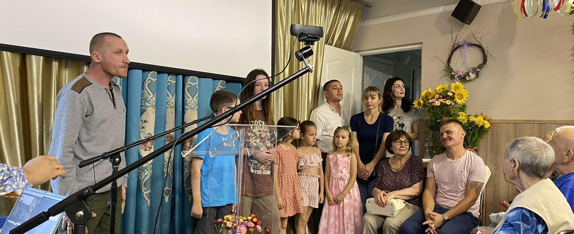
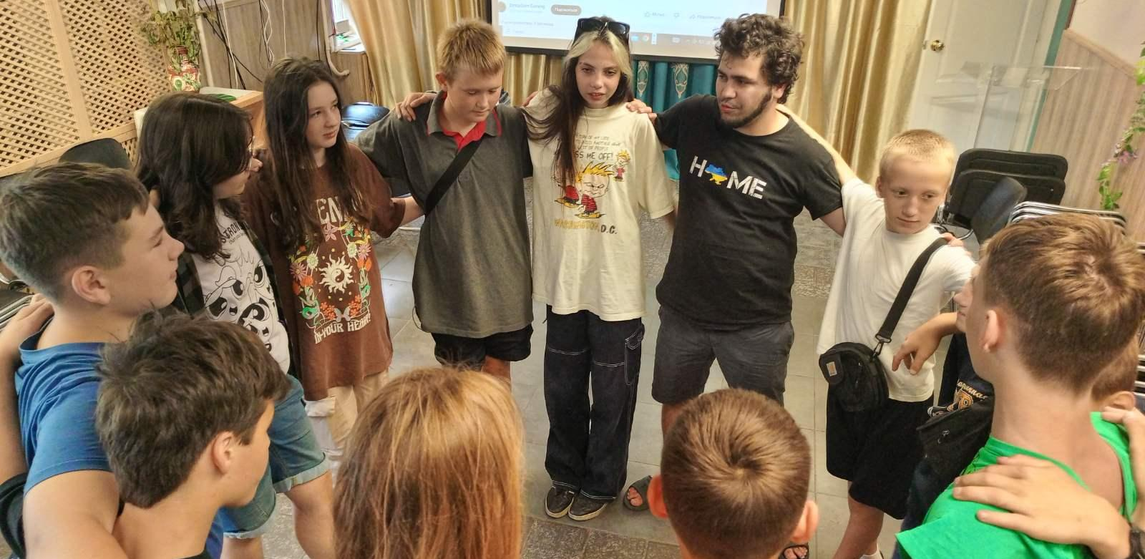
With the beginning of a full-scale war in Ukraine, the Church in Obolon continues to work with children, to provide spiritual and psychological support to children.
The church has a permanent employee - a youth pastor who constantly maintains contact with all the children.

Slide 6
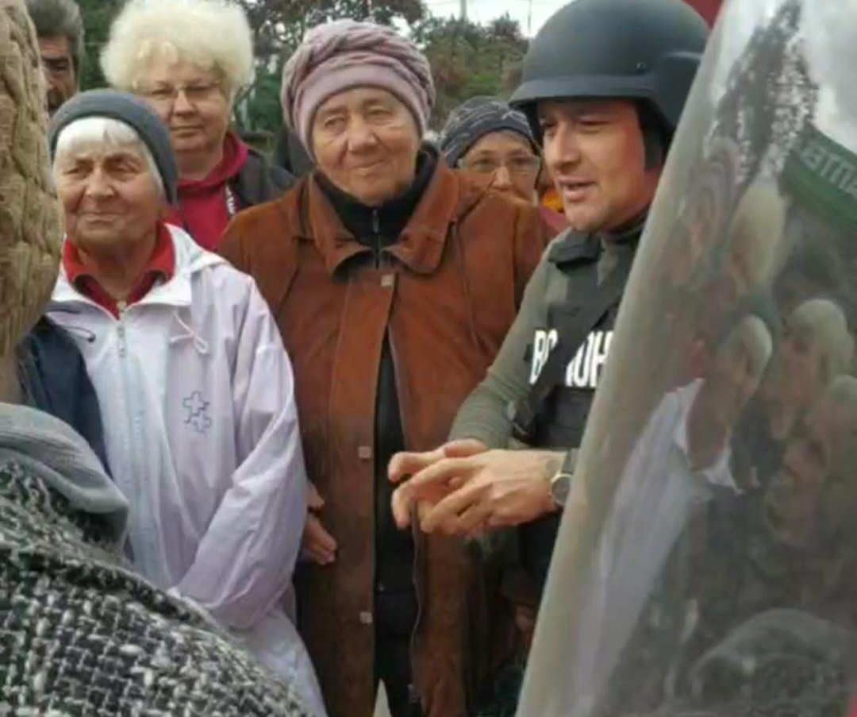
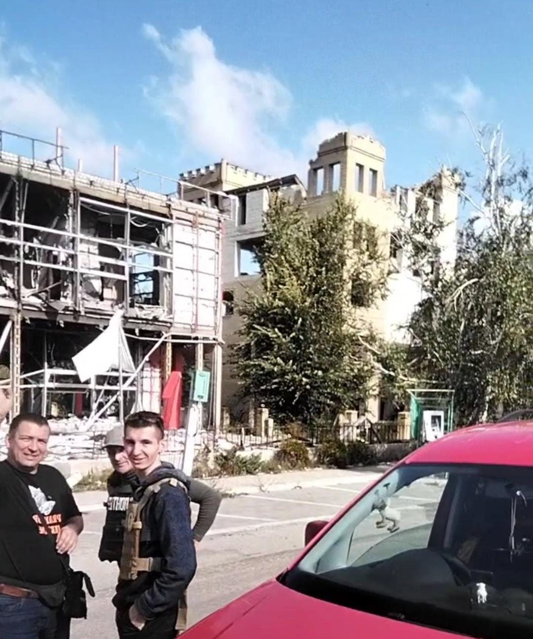
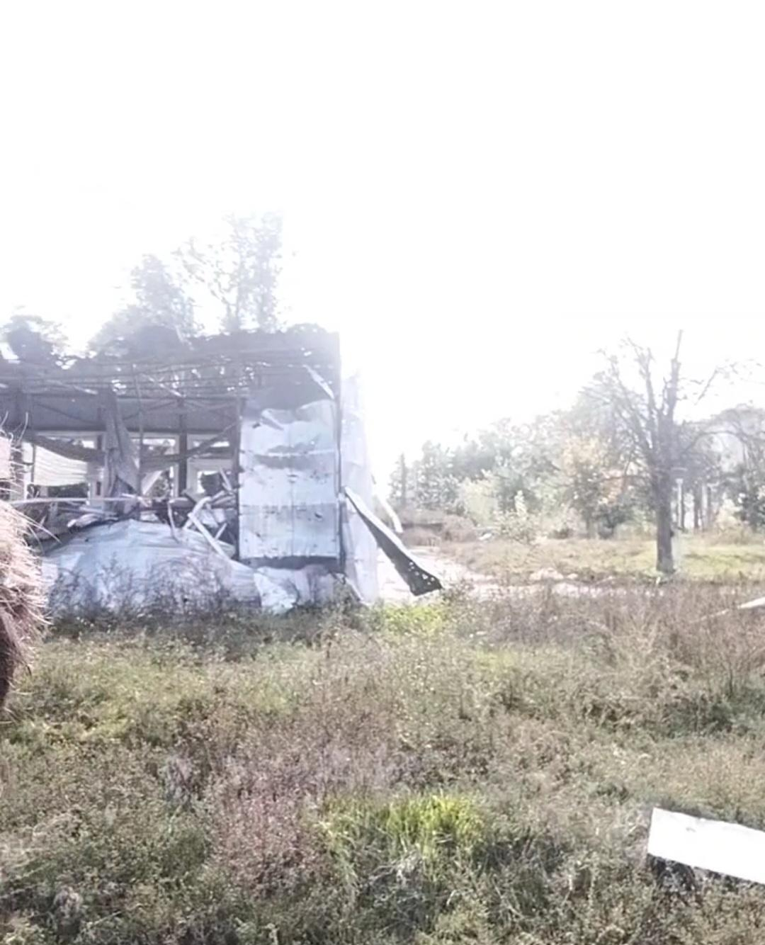
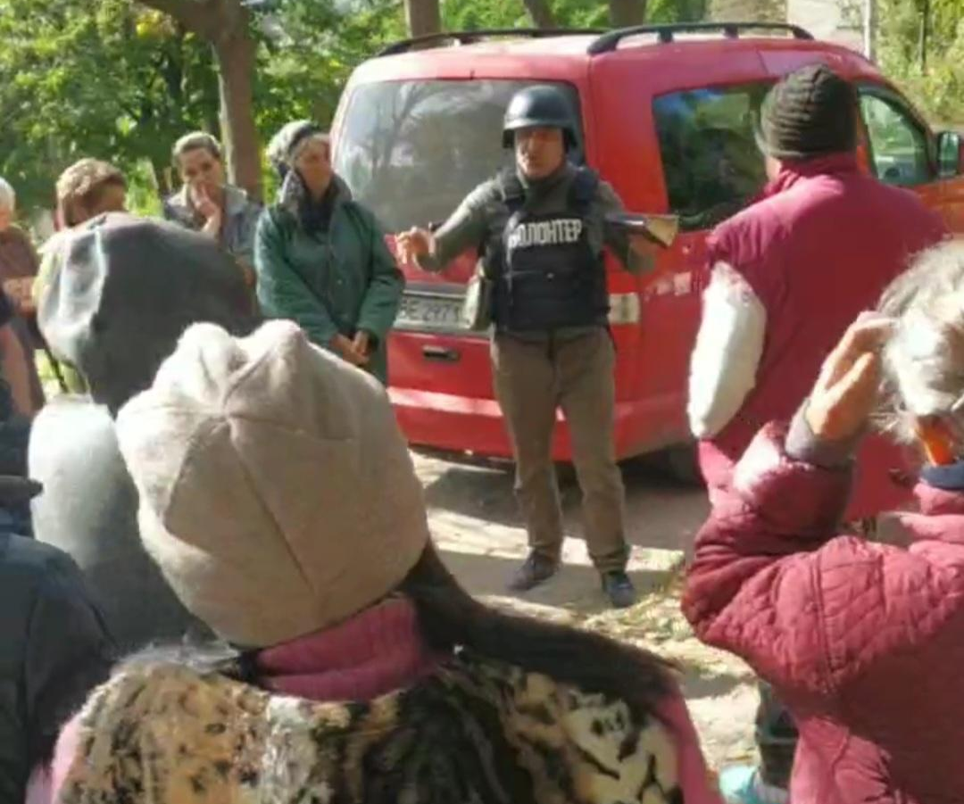
Since the beginning of the war, many cities and villages were occupied by Russian troops.
After the deoccupation, the church visited these cities to provide assistance to the people.

Slide 7
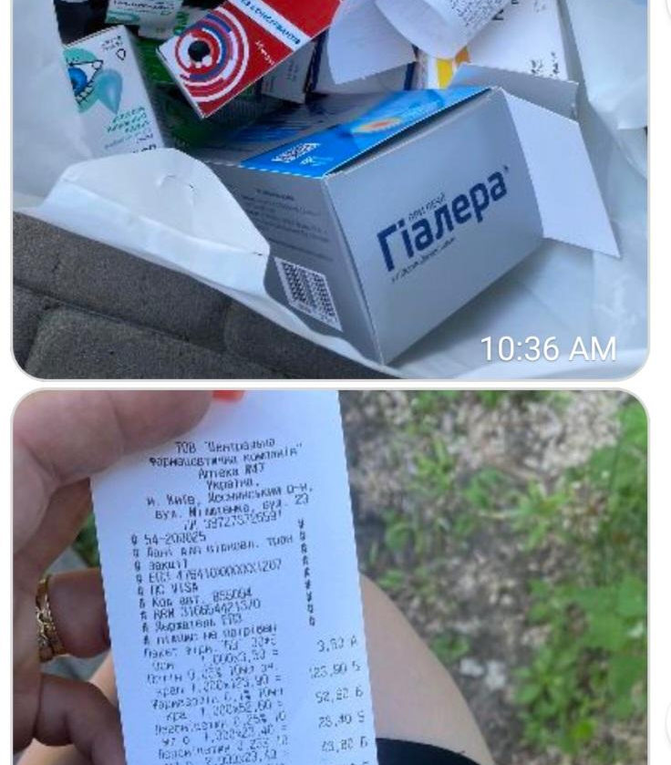
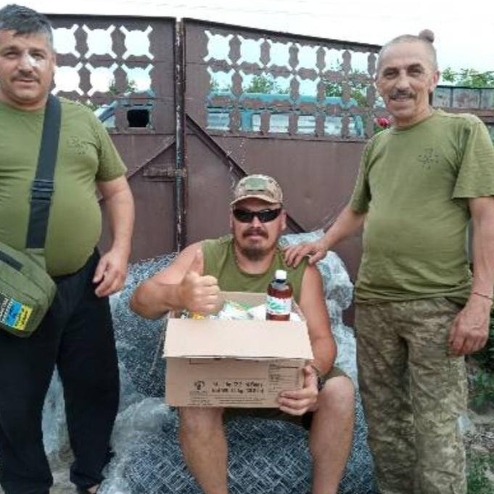
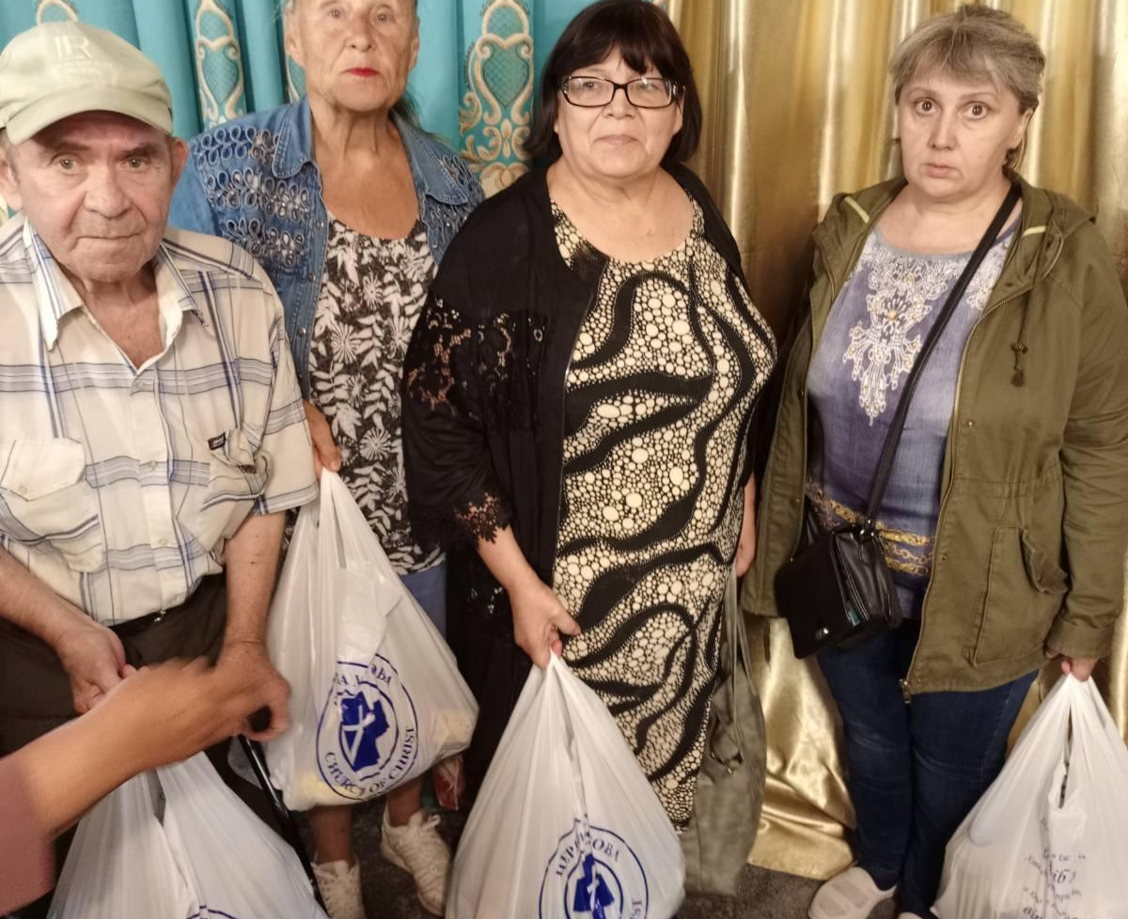
Today, the church provides food assistance to displaced persons, helps to purchase medicine, and provides assistance to the military.

Slide 8
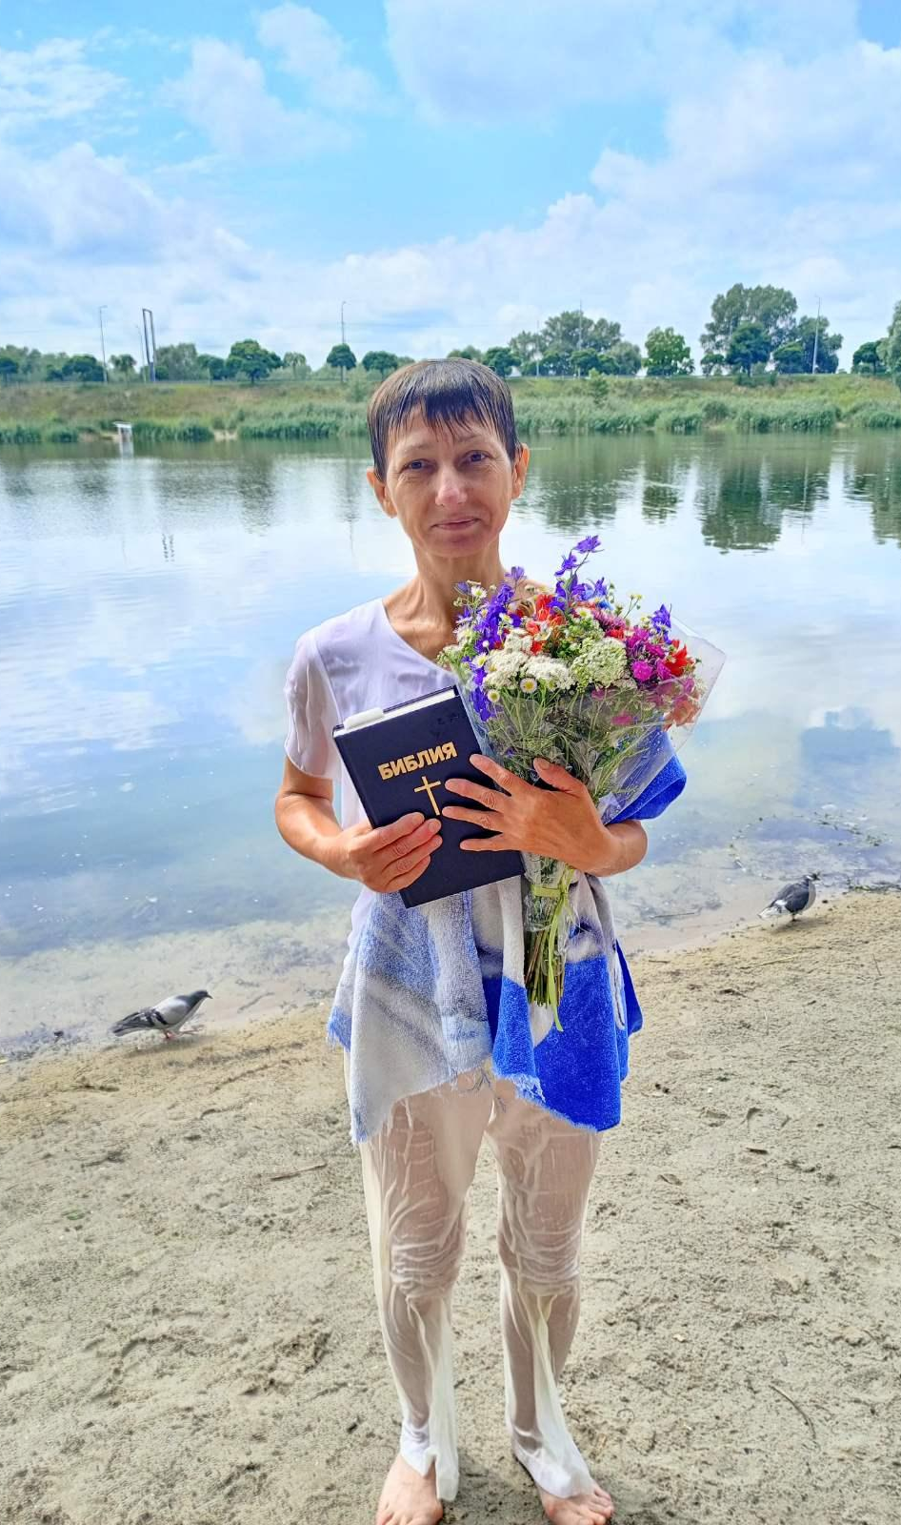
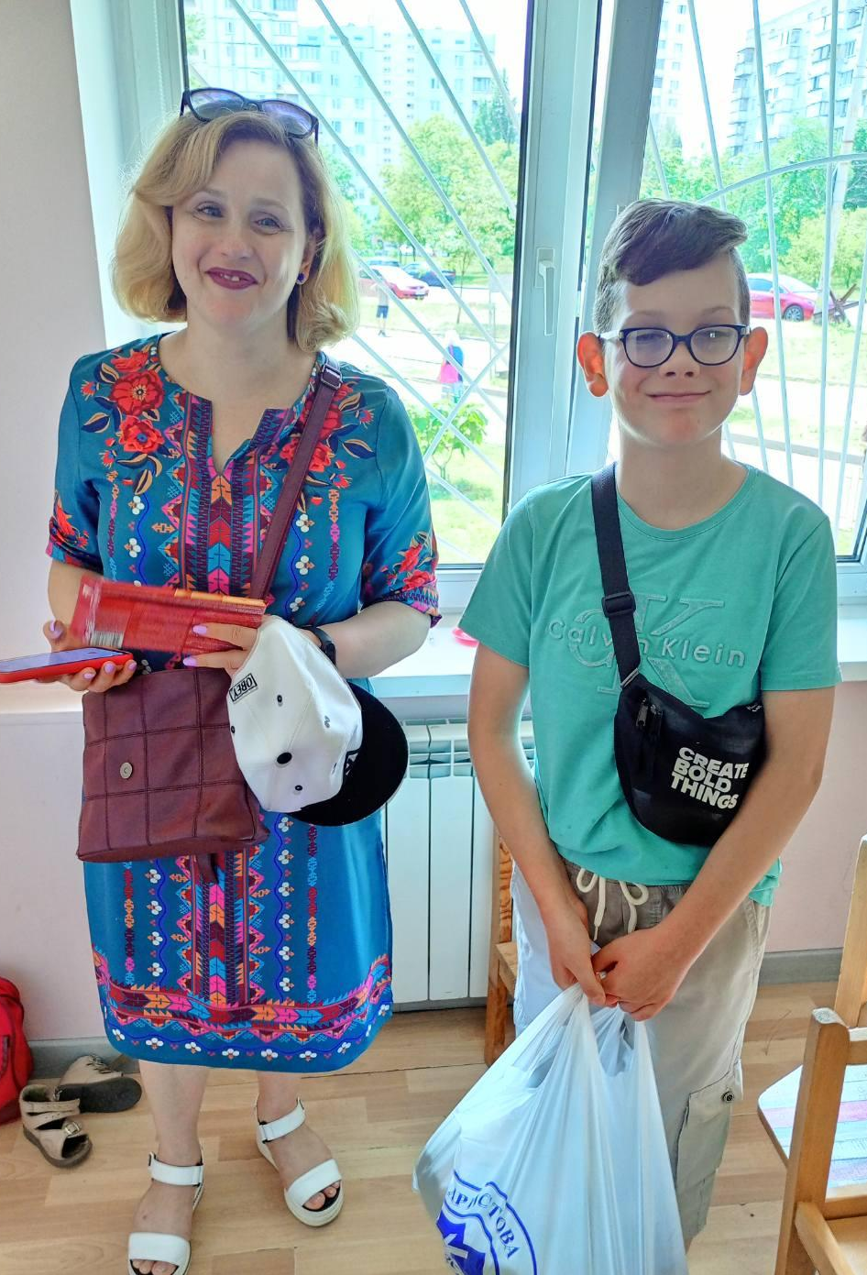
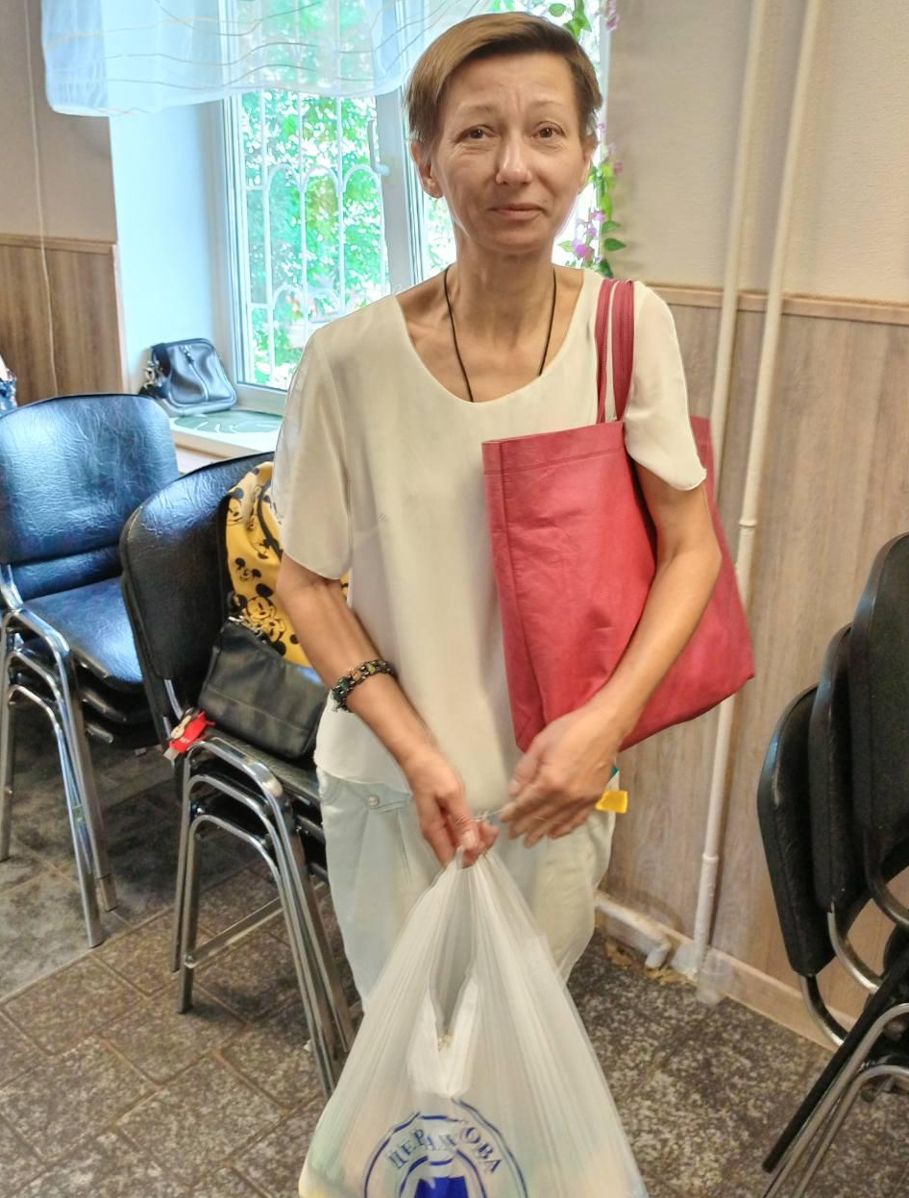
Forced migrants continue to go to church, and accept water baptism to live with God!

Slide 9
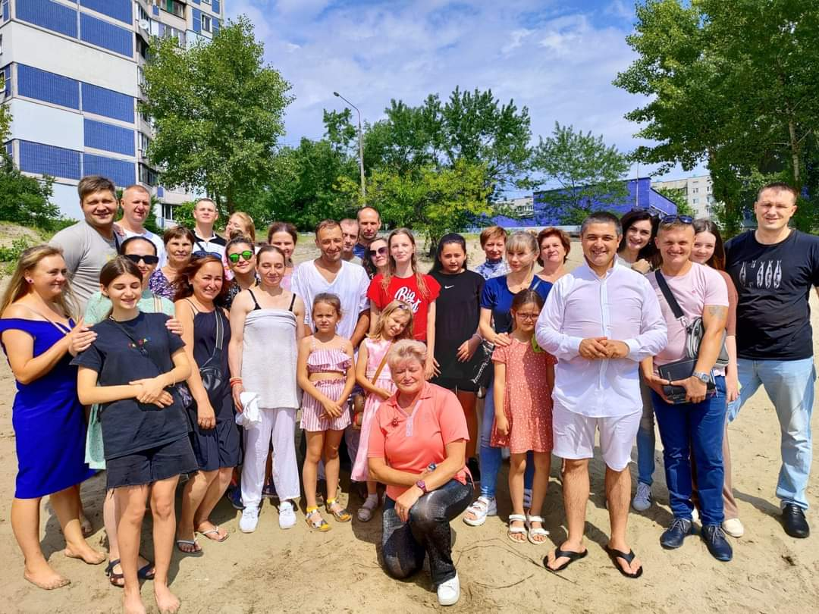
The Church of Christ in Obolon is alive and active in service. Especially in difficult times, many people need help, and the church provides it if it has the opportunity.
We pray to God for financial support for all active ministries.

Slide 10
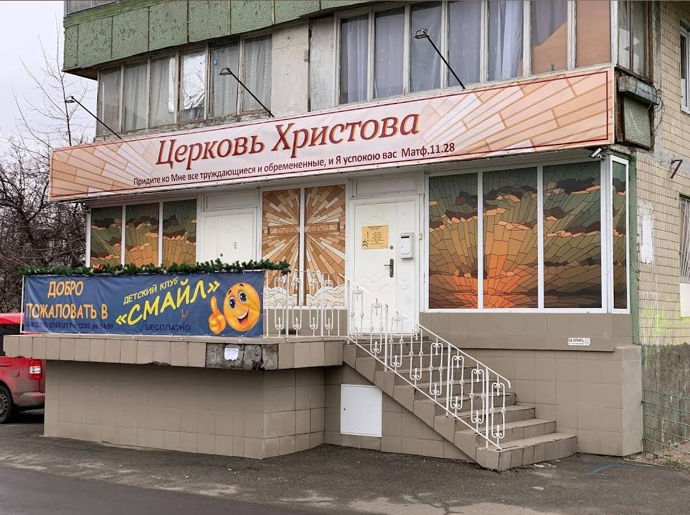
Contact information: 18 Yordanska Street, Kyiv, Ukraine, 04210
Preacher:
Yevgeniy Shevchenko +14313631009
*now in Canada

